Slide 1

MLE Assessment: Compliance for Customer Communication
Sampada Kulkarni
Date: February 2026

Slide 2

CHALLENGE
The Compliance Imperative
The Challenge
Critical Requirements
Collections agents must engage customers whilst staying fully compliant with FDCPA regulations. The system must handle 5,000 conversations daily in production.
Detect compliance violations with complete traceability
Classify customer situations accurately (product loss vs substandard service)
Minimise operational costs whilst maintaining high accuracy
Deploy production-ready architecture that scales

Slide 3
Design Evolution: Six Iterations to Excellence
Each iteration identified and solved real architectural limitations, progressively optimising for cost, accuracy, and production readiness.
Version
Approach
Key Problem
Cost Impact
Status
v1
Regex + LLM
Missed paraphrased violations, 40% routed to expensive LLM
$0.10
Rejected
v2
SBERT + LLM
Single decision point created failure risk
$0.05
Improved
v3
Role-based LLMs
Struggled with borderline compliance cases
$0.05
Improved
v4
Confidence scoring
Excessive human review reduced efficiency
$0.05
Improved
v5
Dual-judge voting
Both judges shared identical perspective
$0.10
Rejected
v6
Different perspectives
Solved all limitations
$0.05
✓ Optimal

Slide 4
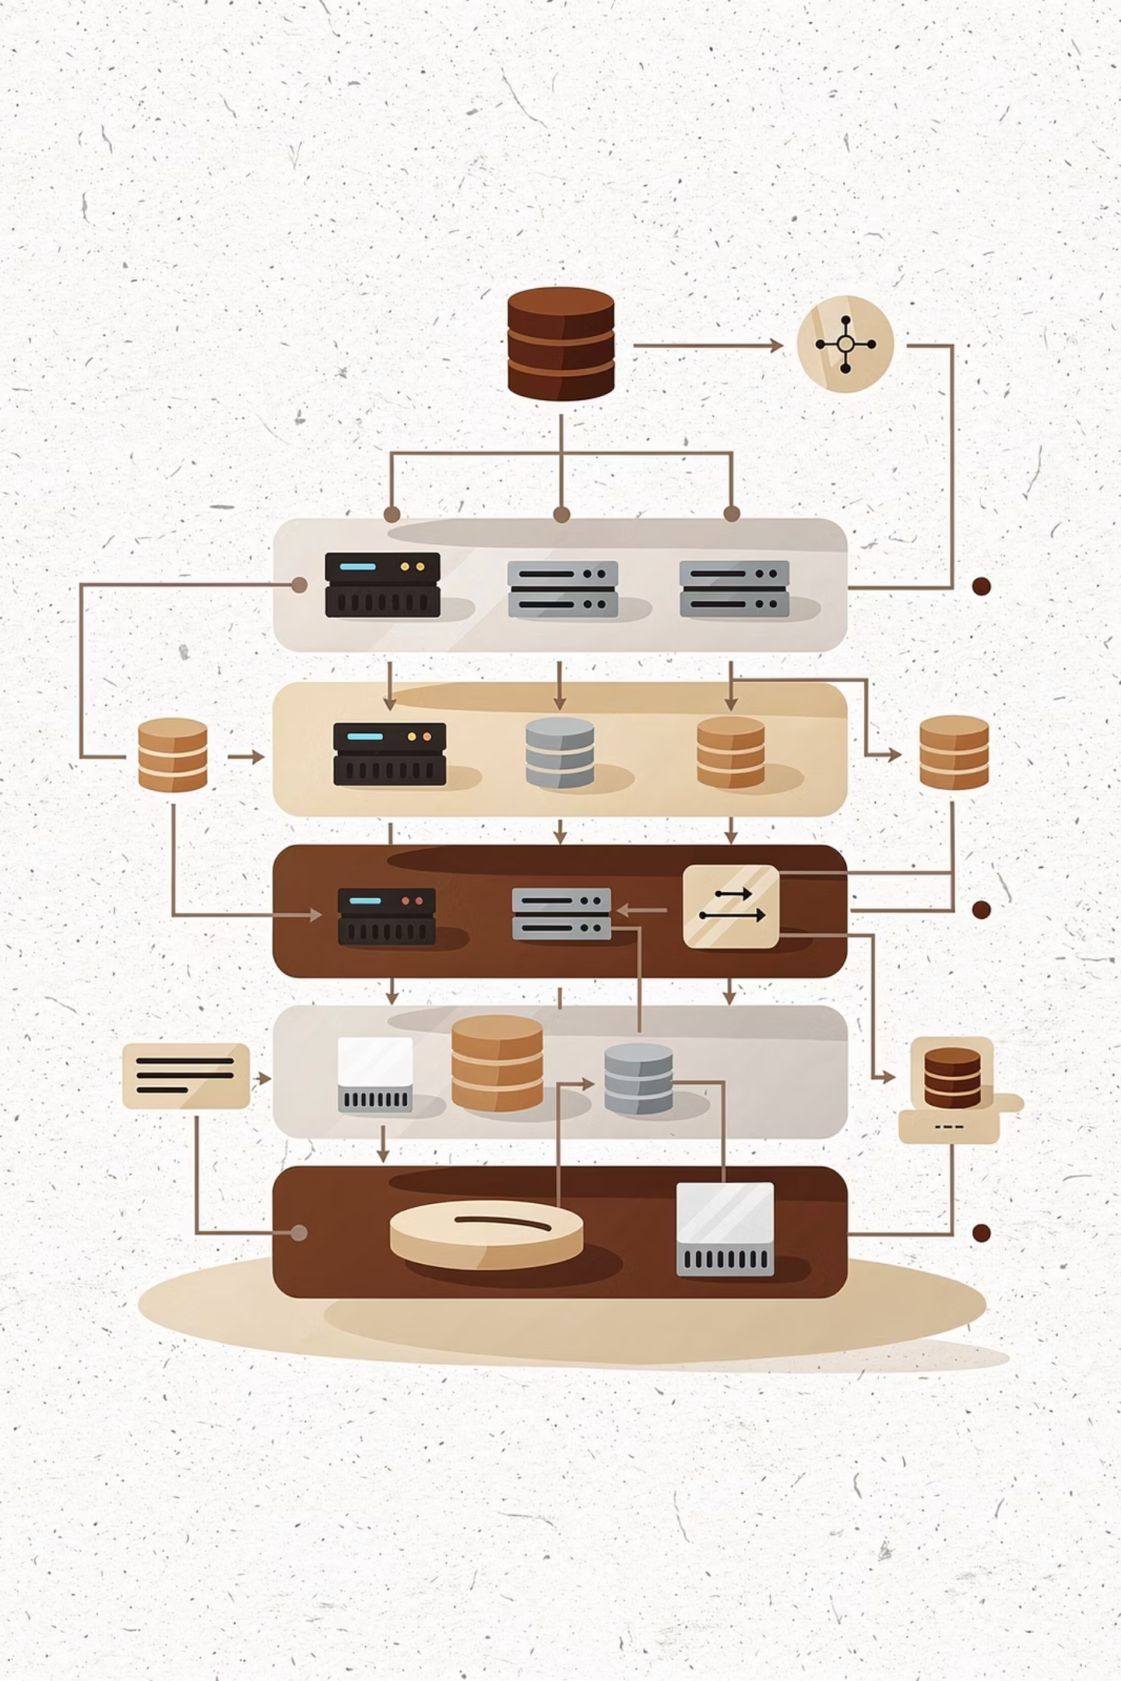

ARCHITECTURE
Two-Layer Hybrid System
Layer 1: Semantic Analysis
SBERT technology processes conversations instantly at zero cost. Handles approximately 80% of cases autonomously with high confidence scoring.
Layer 2: Dual LLM Validation
When confidence is low, two specialised judges validate independently: one strict on rules, one empathetic on experience. Processes the remaining 20% of conversations.
Human Review
Only 8% of cases require human intervention for genuinely ambiguous scenarios, optimising expert time for complex decisions.
92%
$0.0013
Automated Decisions
Cost Per Conversation

Slide 5

LAYER 1
Semantic Matching: Beyond Keywords
Why SBERT Over Traditional Keywords?
Keyword matching fails on paraphrased violations. SBERT embeddings capture semantic meaning, catching "legal action" and "escalate to legal" just as effectively as "sue you".
Processing Pipeline
Embed violation examples once (reusable)
For each conversation, embed agent messages
Calculate cosine similarity (0–1 scale)
Flag violations when similarity ≥ 0.60
Auto-decide when confidence exceeds severity threshold
81%
$0
5s
Auto-Decided Cases
Processing Cost
Average Latency

Slide 6

Severity-Based Confidence Thresholds
Higher-stakes violations demand higher confidence before automated decisions. This risk-adjusted approach prevents costly false positives on critical regulatory issues.
Critical: 85%
High: 80%
Medium: 75%
Compliant: 70%
Legal threats
Harassment
Pressure tactics
Acceptable behaviour
Cannot afford false positives—regulatory consequences are severe
Significant compliance risk requires careful validation
Moderate risk justifies balanced threshold
More lenient threshold reduces unnecessary escalation
Impact: A false positive on "legal threat" triggers major regulatory concerns, whilst a false positive on "compliant" merely represents a missed training opportunity. Adaptive thresholds reflect this reality.

Slide 7
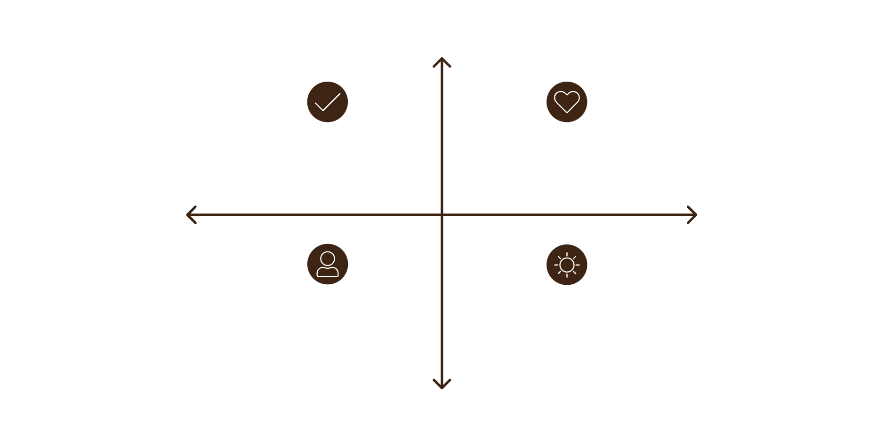
LAYER 2
Dual Judge System: Two Perspectives, One Goal
High Regulatory Confidence
Strict Approve - Meets Regulations
Empathetic Approve - Good Experience
Decision Logic
Low Customer Experience
High Customer Experience
Both agree + confidence ≥ 75% → Auto-validate
Both agree + confidence < 75% → Human review
Judges disagree → Human review
Empathetic Reject - Harmful UX
Strict Reject - Noncompliant
Low Regulatory Confidence
Different perspectives catch what single-view systems miss. When judges disagree, the system flags genuinely borderline behaviour for human review.
Judge 1: Strict Compliance
Judge 2: Empathetic Compliance
Focuses exclusively on regulatory violations, ignoring tone and empathy. Catches clear breaches of FDCPA rules.
Evaluates both rules and customer experience. Identifies poor service alongside violations.

Slide 8
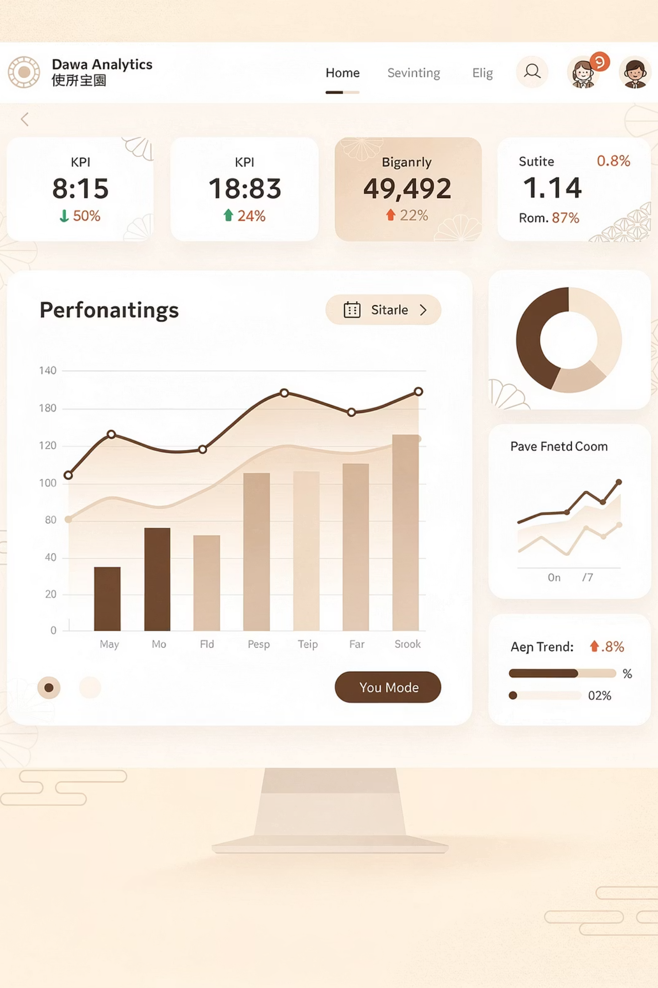
PERFORMANCE
Results & System Performance
Test dataset comprised 200 conversations with randomised distribution across violation types and severity levels.
01
02
Layer 1 Processing
Layer 2 Validation
Processed all 200 conversations. Auto-decided 162 cases (81%) with zero cost. Sent 38 low-confidence cases (19%) to Layer 2. Average processing time: 5 seconds.
Processed 38 conversations through dual judges. Validated 30 cases automatically (79%). Escalated 8 genuinely ambiguous cases (21%) to human review. Average processing time: 60 seconds.
03
Combined System Results
Achieved 92% automation rate with only 8% requiring human review. Total cost per conversation: $0.05. System maintains full traceability for regulatory audits.

Slide 9
Production-Ready Technical Implementation
Technology Stack
Schema-Driven Validation
Full Traceability
Layer 1: Sentence-BERT (all-MiniLM-L6-v2) with 384-dimensional embeddings
Layer 2: GPT-4o-mini for both judges with JSON structured output
Configuration: JSON files enabling threshold adjustments without code changes
Prompts: Markdown files under version control with testability
Outputs: JSON for machines, Excel for humans
Rule ID, message index, matched text, similarity scores
Validates against API contracts in docs/api/
Cost Tracking
Error Handling
Per-conversation breakdown for financial monitoring
Retry logic and fallback mechanisms
Code Quality: Modular architecture separating concerns, type safety via dataclasses, comprehensive logging, and clear documentation throughout.

Slide 10

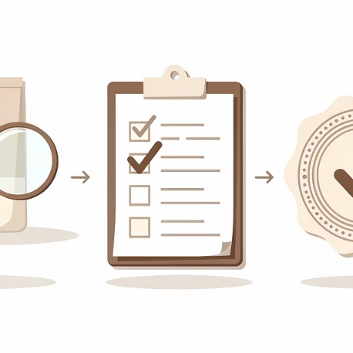

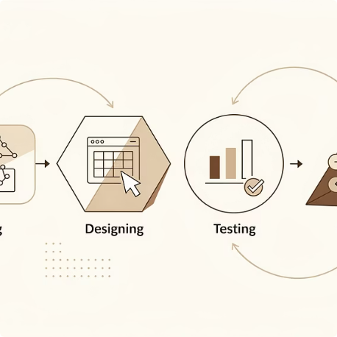
Key Takeaways & Business Impact
Cost-Conscious Design
Quality-Focused Validation
Production-Ready Architecture
Iterative Excellence
Intelligent filtering achieves 80% cost savings compared to full LLM processing. $27 monthly cost for 5,000 conversations.
Six design versions progressively solved real limitations, demonstrating rigorous engineering discipline.
Dual judges with different perspectives catch subtle compliance issues that single-view systems miss.
Configurable, traceable, and scalable system ready for enterprise deployment with full audit capabilities.
Strategic Trade-offs
Next Steps
Chose 92% automation over 100% to optimise cost-quality balance
Accepted 1.5s latency for dual validation quality
Semantic matching captures most paraphrases effectively
Fine-tune SBERT on compliance-specific conversation data
Implement embedding caching for repeated phrases
Add real-time monitoring dashboards

Slide 11
Thank you

